Slide 1
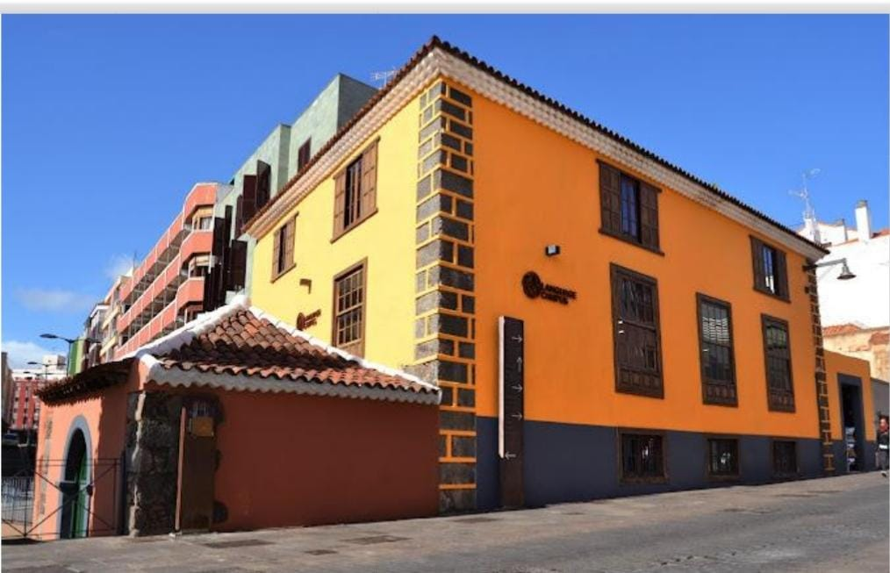
Experiential Learning:
Tenerife through Nature and History
Language Campus,La Laguna, Tenerife
30-5 July,2025

Slide 2
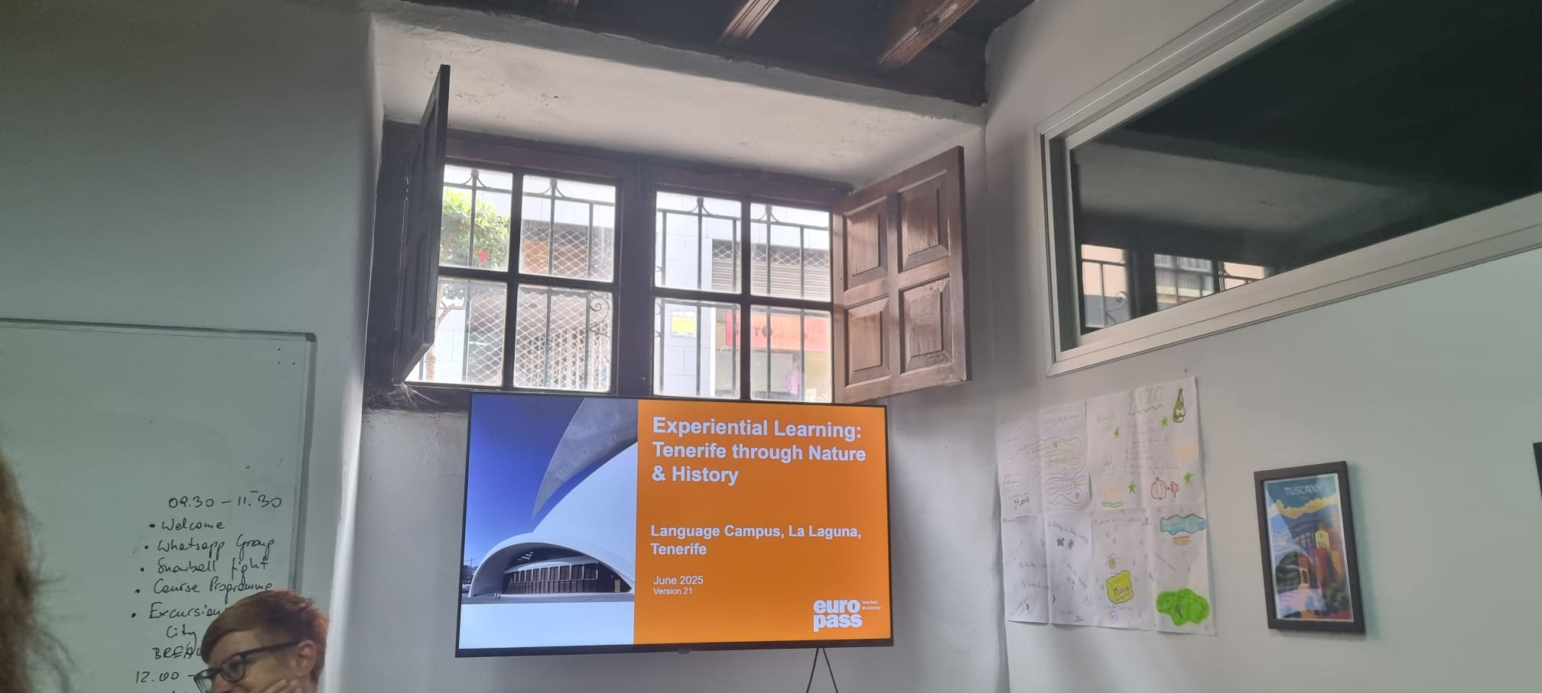
Welcome!
Introduction
Exercusion options & pratical information
Get to know the other participant
Guiding multimedia Input Cycle & Experential Learning
Introduction to natural Canary history and archeology and socrative quiz
Multiple intelligences theory
Introduction to vulcanic nature of Canaries with personalized Volcano poems.

Slide 3
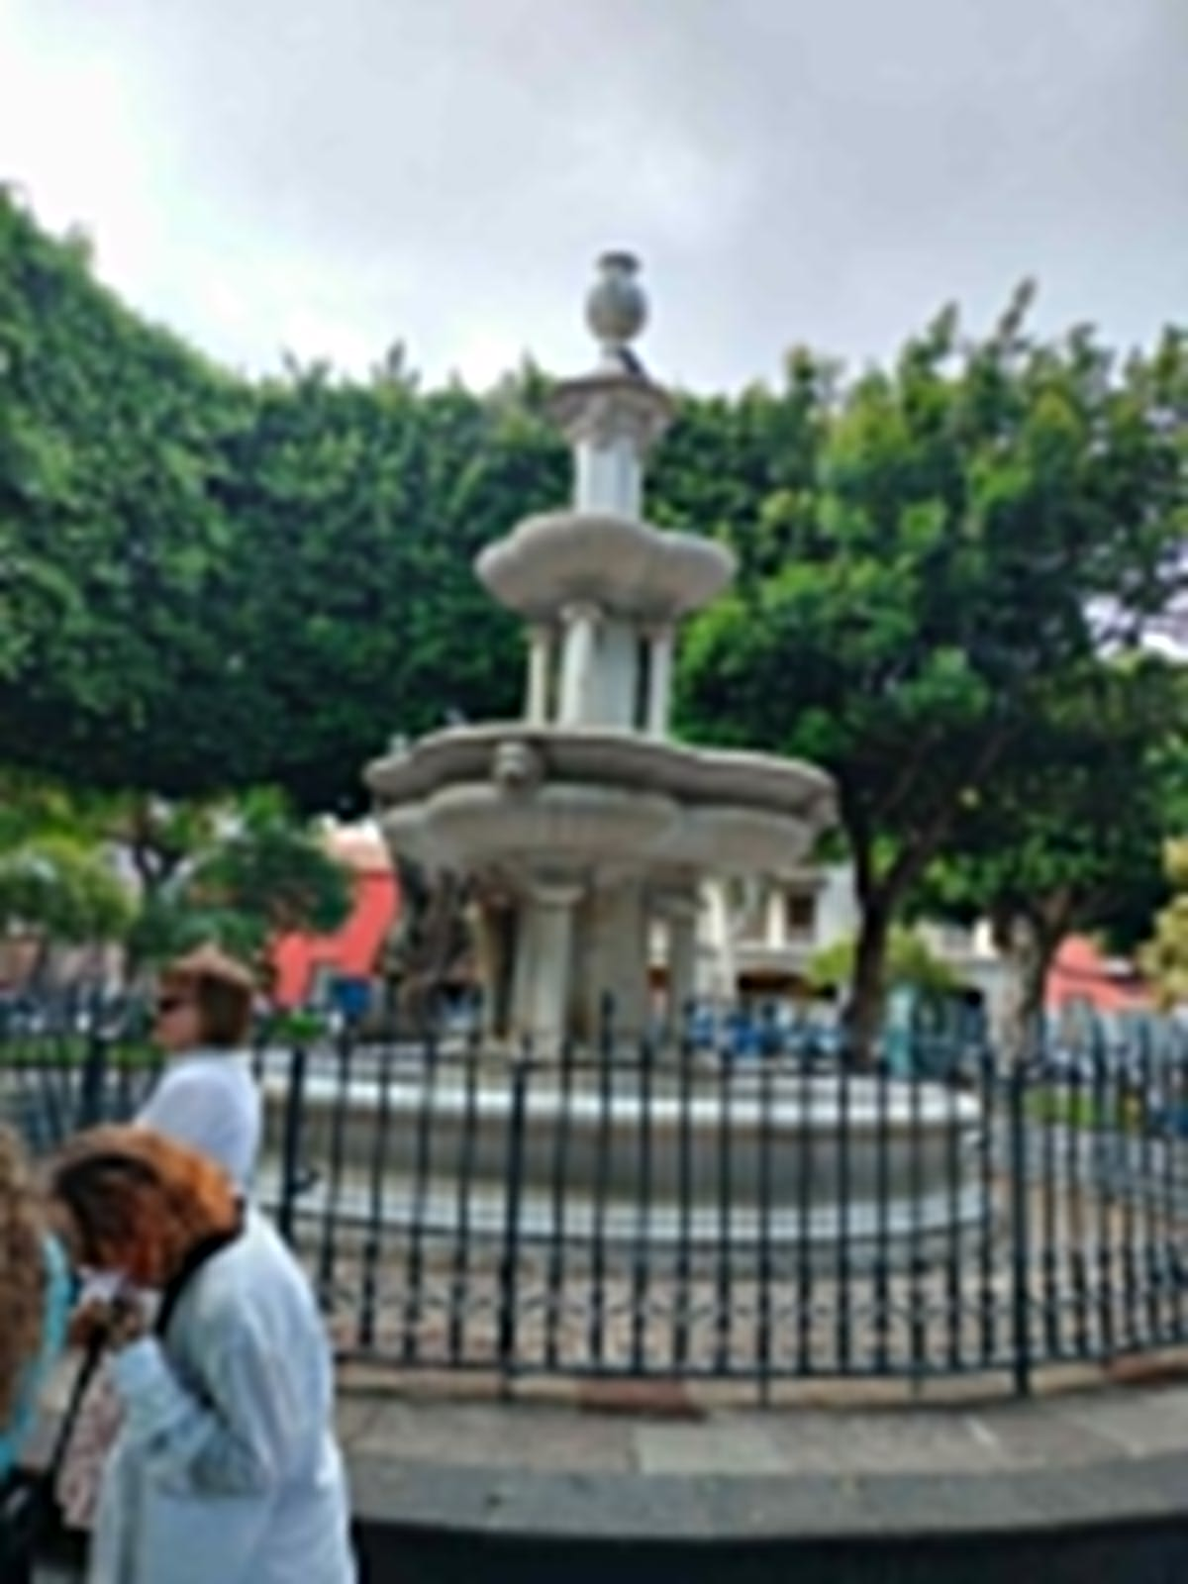
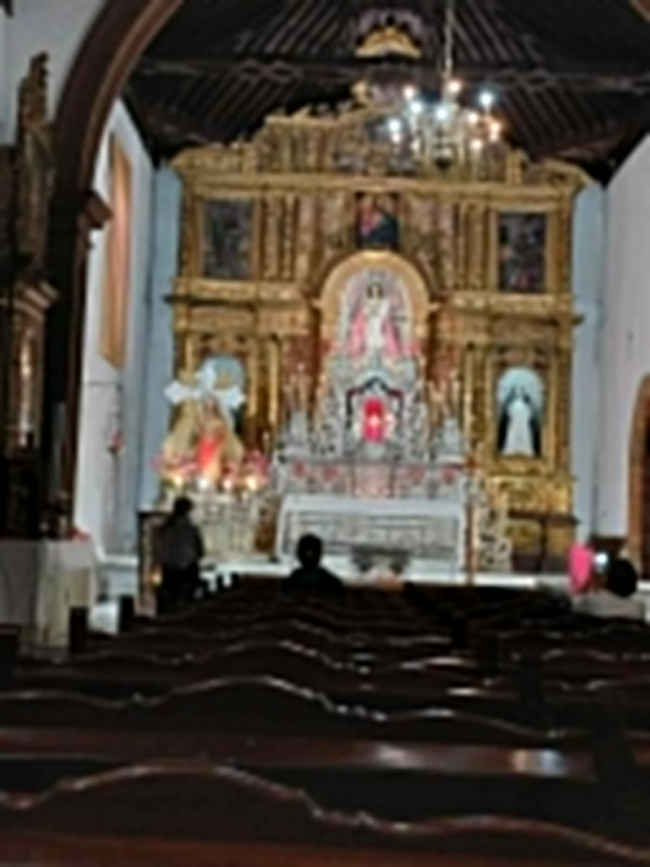
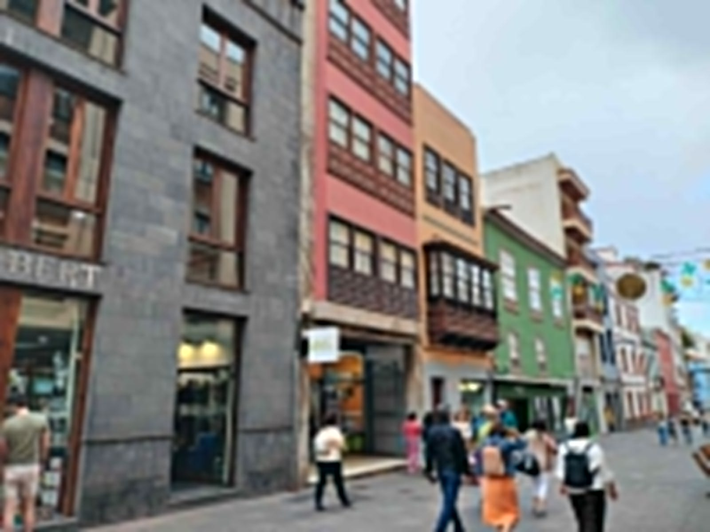
Meeting point at 5pm at Language campus
Walking tour to find out the historical roots of the city:

Slide 4
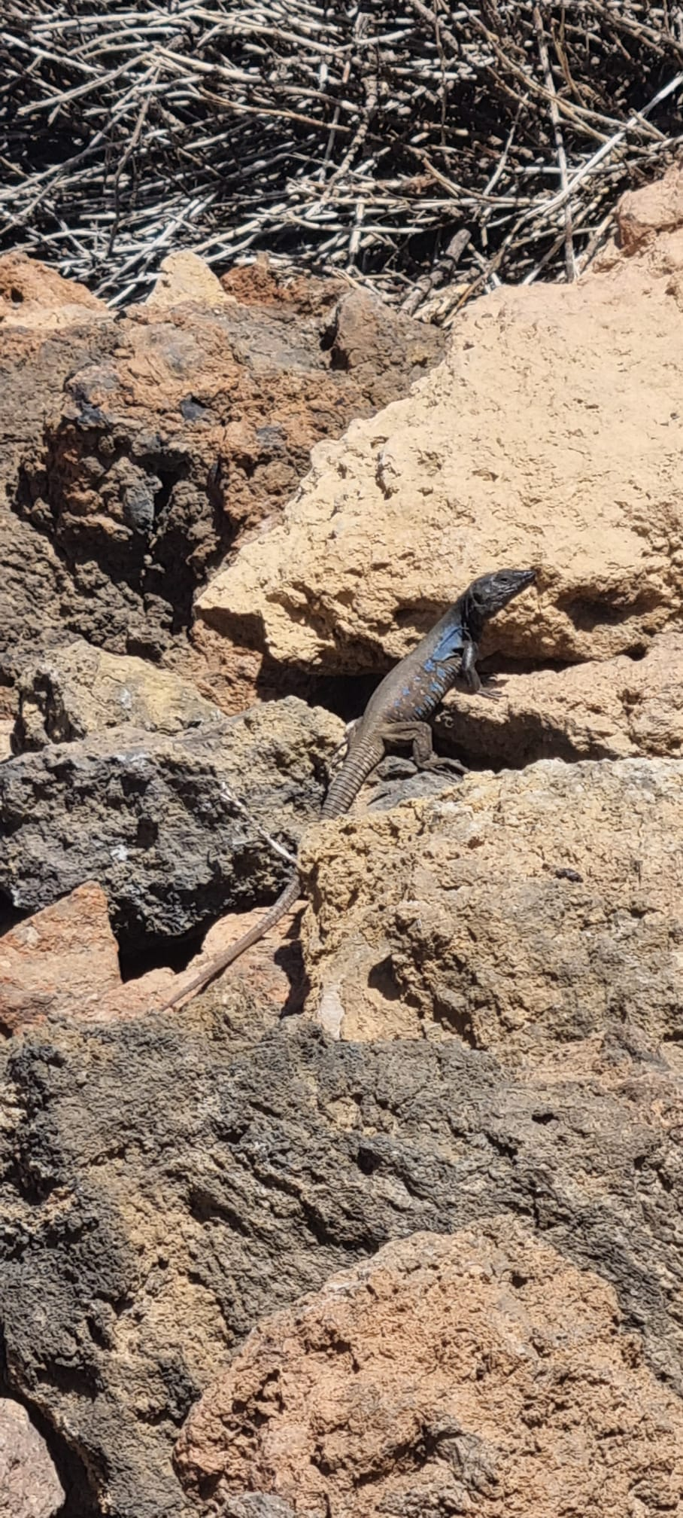
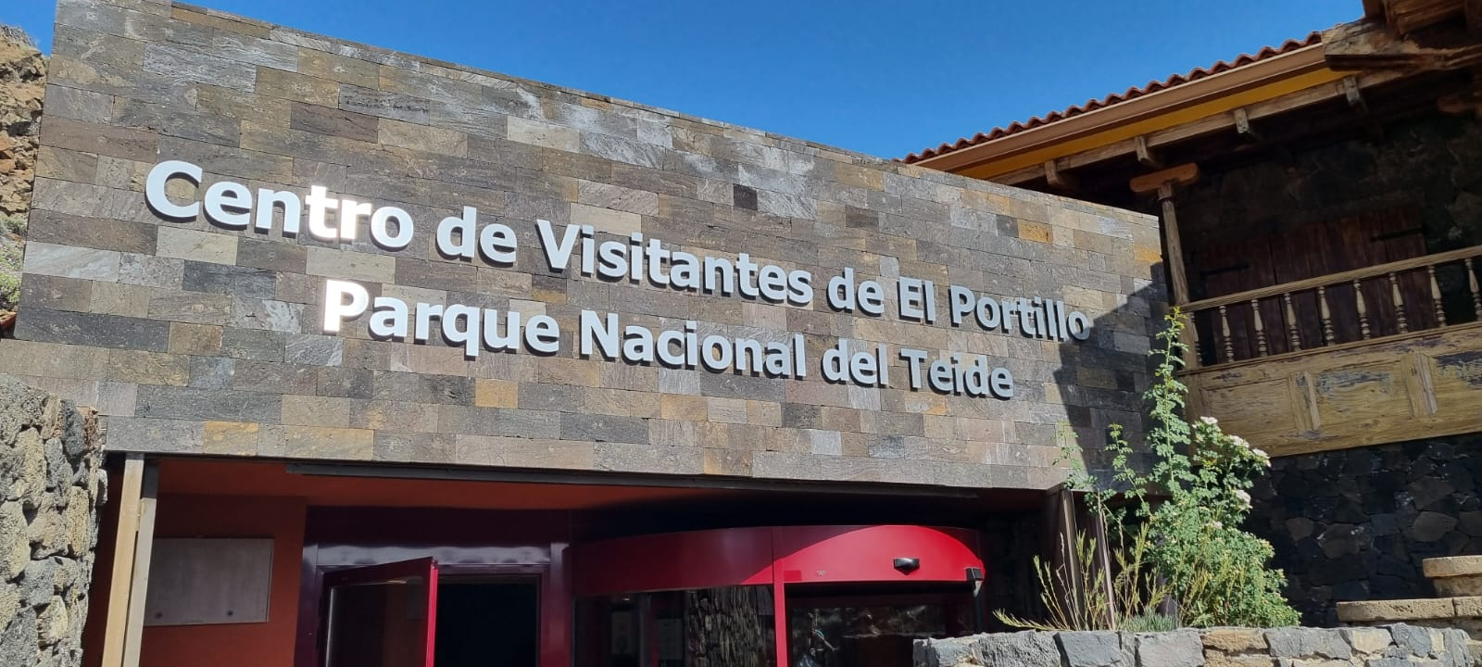
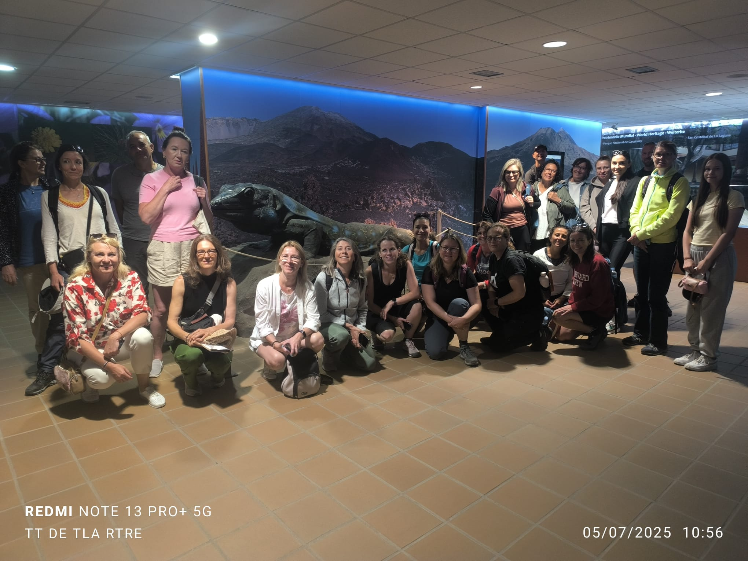
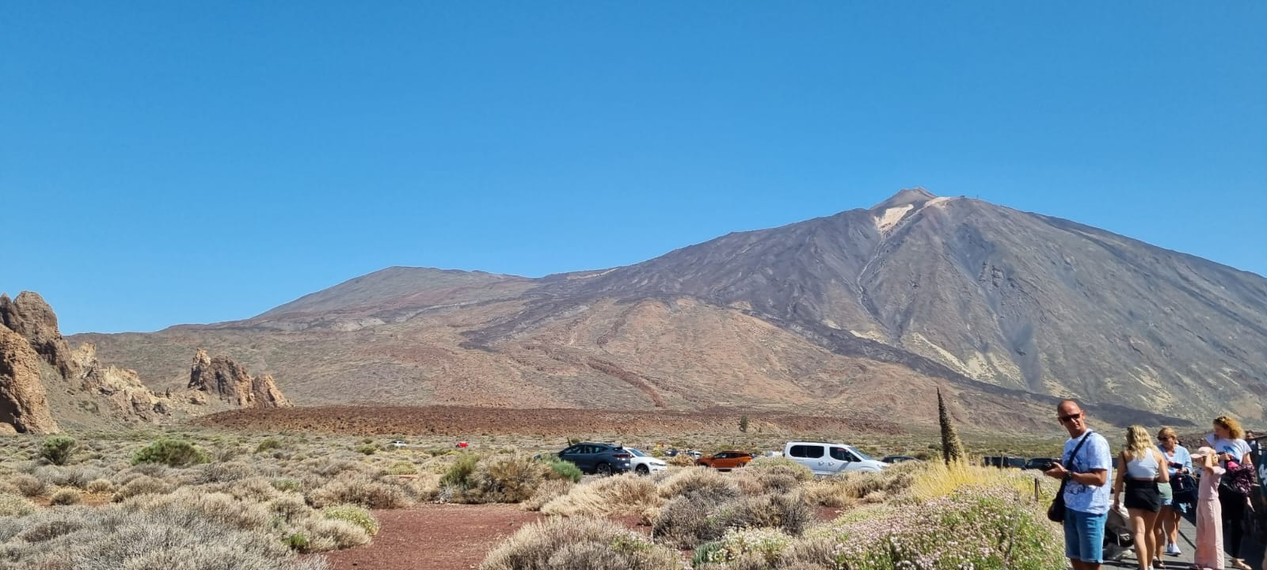
Teide Park: excursion on 5th July
Excursion to Teide National Park
A winding path weaves through ancient trees,where sunlight barely filters through the dense canopy.
Volcanic landscape the ground turns rough and dark scarred by hardened lava flows and steaming craters.

Slide 5
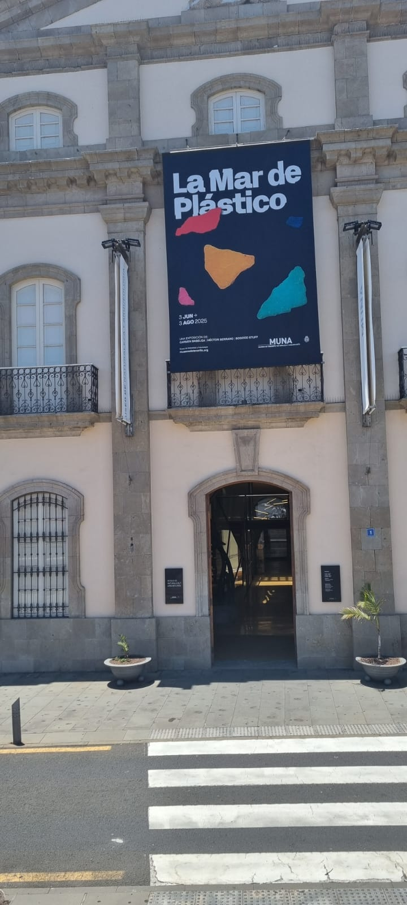
Muna (Museo de Arquelogia y Naturaleza) Santa Cruz
Five senses meditation
I notice ,I wonder,It remainds me of»
«Go and find out»activity with the action bound app
An active museum visit
El mundo funerario investigating the world of the Guanche

Slide 6
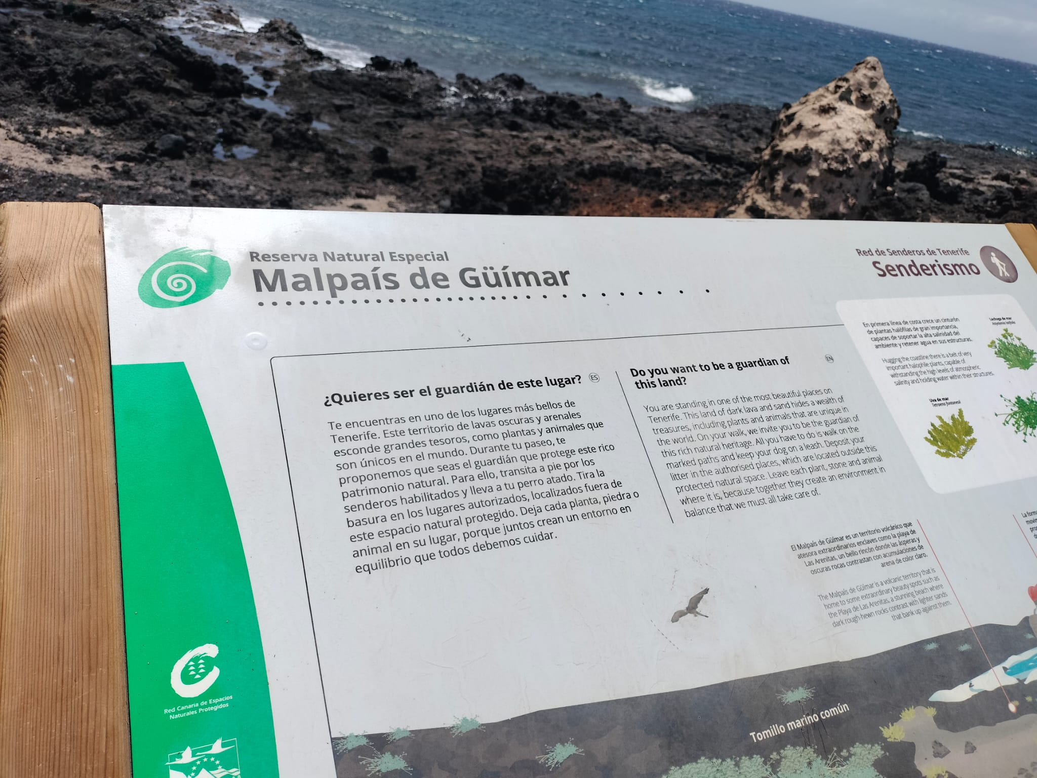
Malpais de Guimar
Outdoor activities: History culture and Environment
Expressing our Knowledge in art and words
Walk around The Malpais de Guimar lava field looking for Volcanic Characteristics
The Italian group tried the seawater after lunch

Slide 7
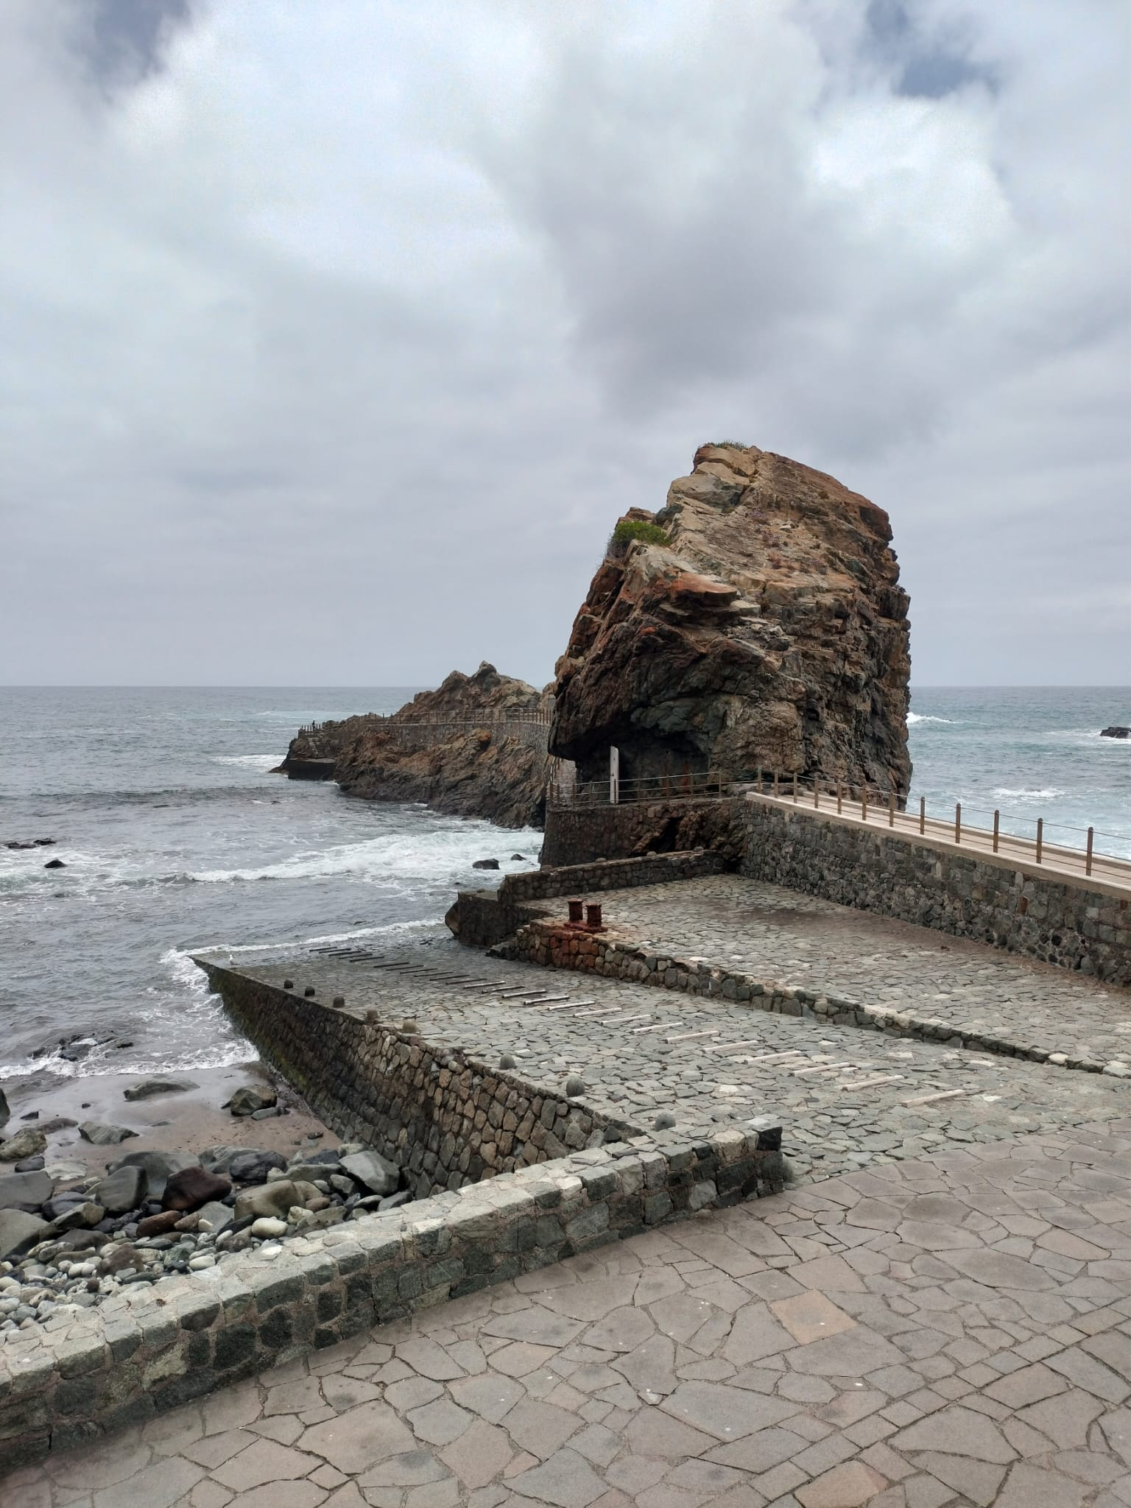
Taganana,Anaga Mountains
Indoor and outdoor activities
Walk around the Taganana village

Slide 8
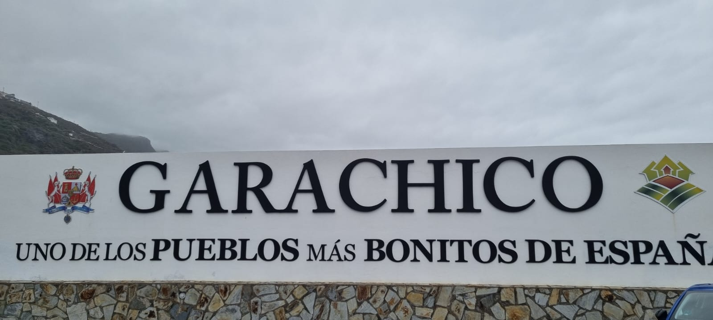
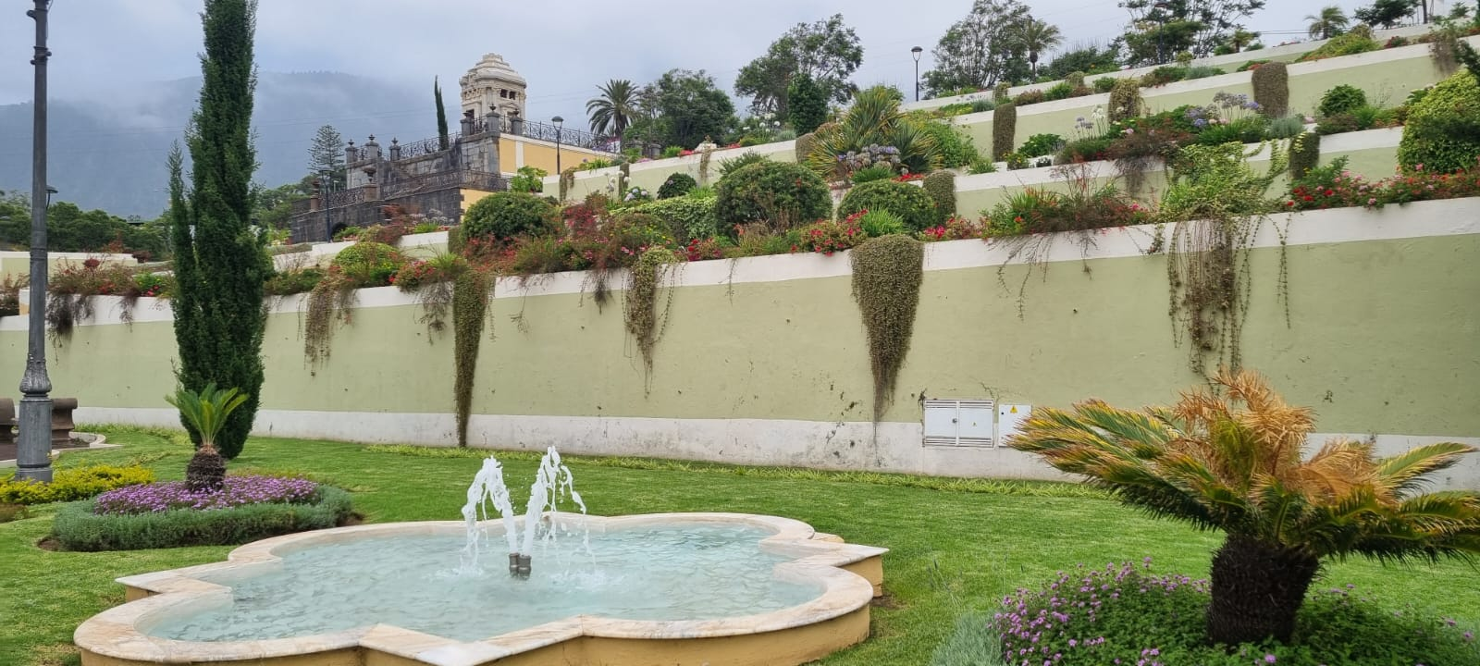
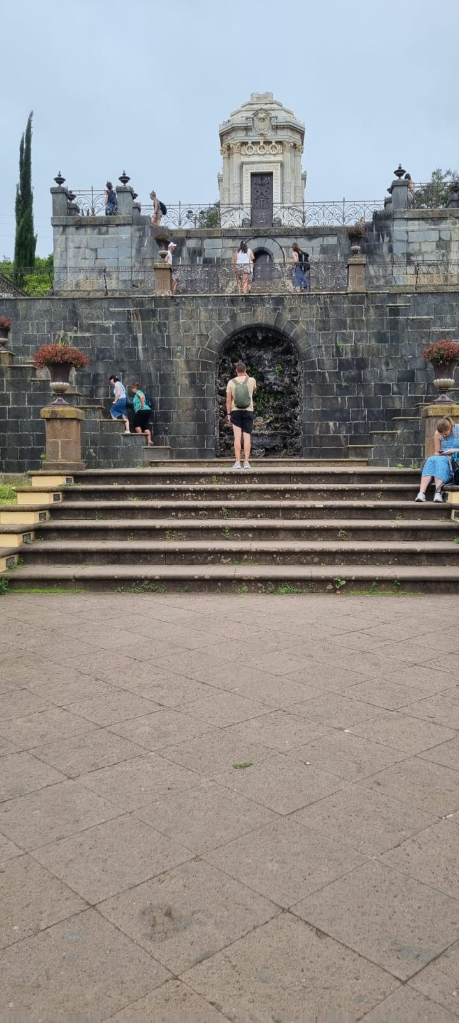
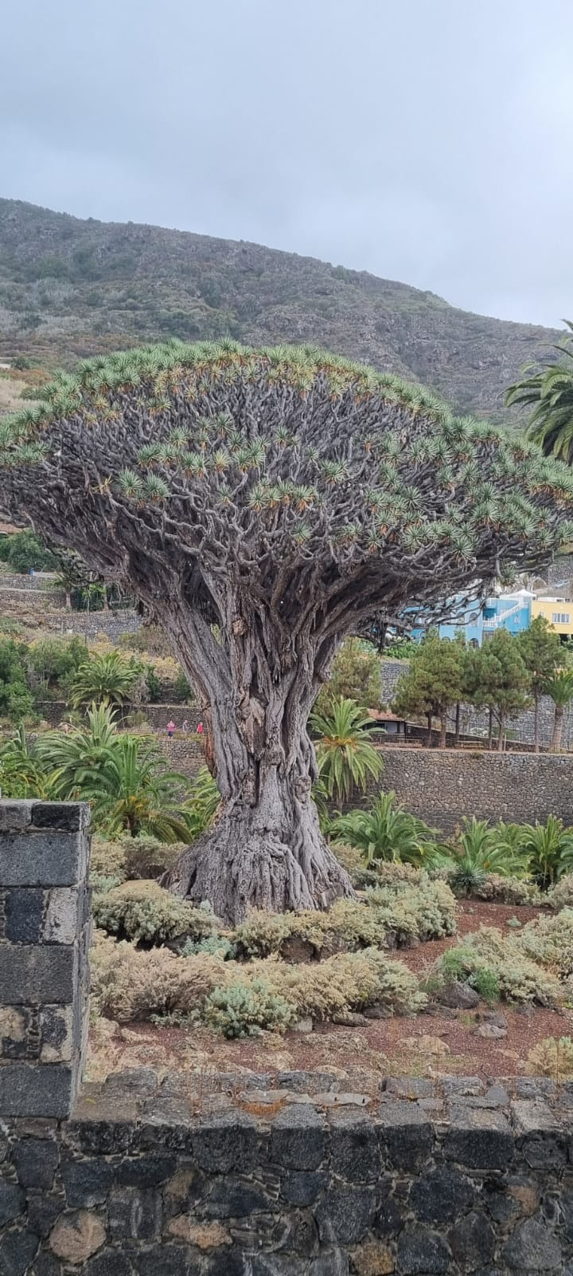
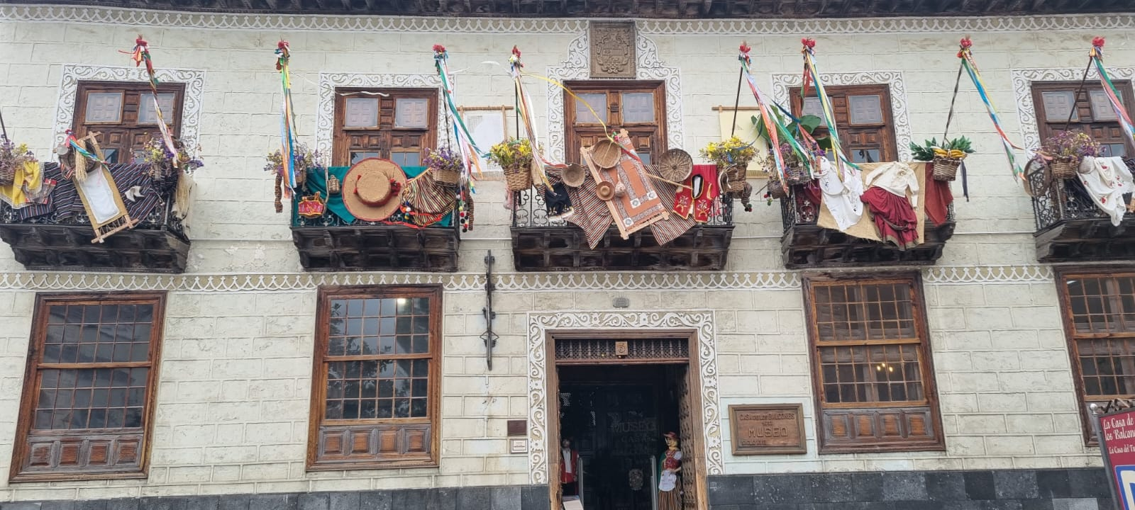
Northern cities tour on Friday 4th Juy
La Orotava-Icod de losVinos-Garachico
Trip to three cities of the north coast
Immersed in the heart of the island in a natural and historically signifcant landscape
The Oldest dragon tree in the city
The house of balconies, famous for being built by the first italian to arrive on the island

Slide 9
Learning from Direct Experience
Sensory
Physical
Emotional
Social
Responsibility
Failing

Slide 10
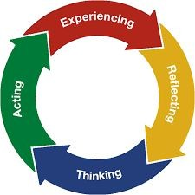
THE CYCLE

Slide 11
Learning from direct experience at school
Science experiment
Field trips
outdoor education
simulation
art and music performance
Role-playing exercise
Reflecting on direct experience

Slide 12
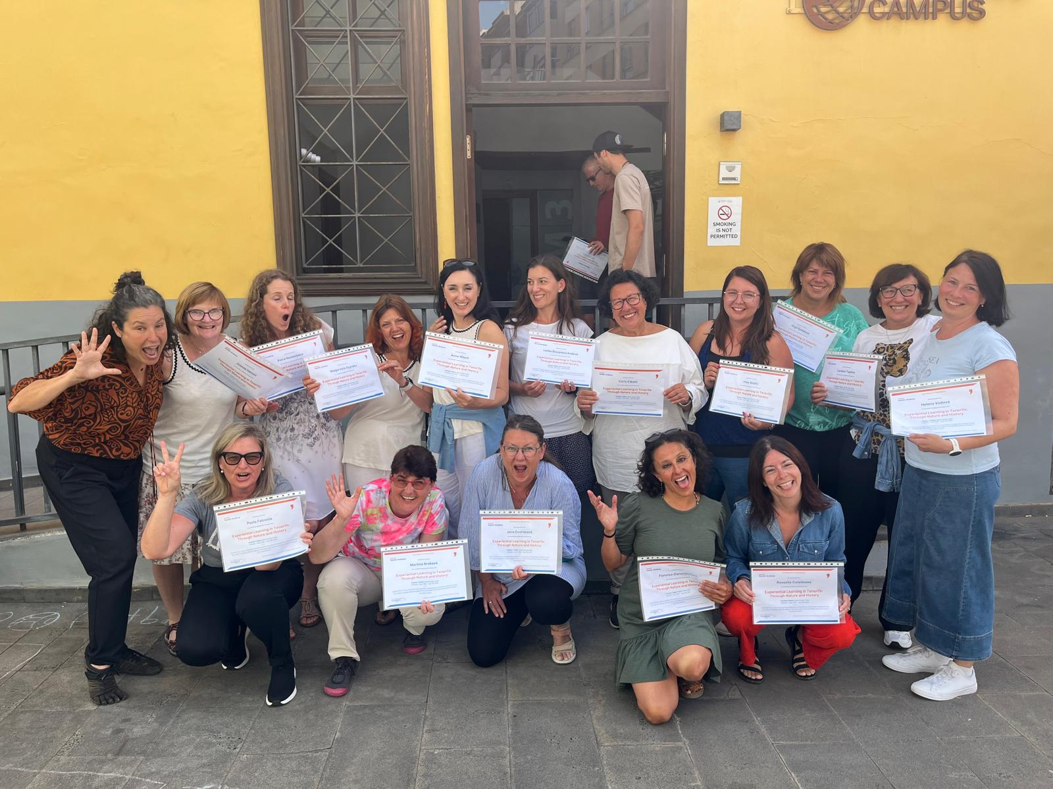
Language Campus, La Laguna
Multiple intelligences round-up
Experiential Cycle reflections
Feedback and discussion
«Volcano choir»
Giving certificates,making evaluation,taking photo
Lunch time
Ecursion to the Northen cities: La Orotava-Icod de los Vinos and Garachico

